Slide 1
Financial Data Analysis
Presented By
Anant Anugrah Tudu

Slide 2

Introduction
In today's competitive landscape, understanding market dynamics is crucial for business survival and growth. This project delves into the realm of financial analytics, specifically focusing on analyzing market capitalization data of the top 500 companies in India. By examining key metrics and uncovering meaningful relationships between attributes such as market capitalization and quarterly sales, this analysis aims to provide valuable insights for strategic decision-making.

Slide 3
Details of Data
Name of the Company: This column contains the names of the companies included in the dataset. Each row corresponds to a specific company identified by its name.
Market Capitalization in Crores: Market capitalization refers to the total market value of a company's outstanding shares of stock. It is calculated by multiplying the current market price of a company's shares by the total number of outstanding shares. The value is typically expressed in Crores, which is a unit denoting ten million in the Indian numbering system. This column provides the market capitalization of each company in Crores (Indian Rupees).
(Quarterly Sales in Crores): This column represents the quarterly sales figures of each company, measured in Crores (Indian Rupees). Quarterly sales indicate the revenue generated by the company during a specific quarter, reflecting its business performance over that period.

Slide 4
KPI
Market Capitalization Ranking: Rank companies based on their market capitalization.
Quarterly Sales Growth Rate: Measure the percentage change in quarterly sales compared to the previous quarter.
Market Capitalization to Quarterly Sales Ratio: Calculate the ratio of market capitalization to quarterly sales.
Top 10 Companies by Quarterly Sales: List the top 10 companies with the highest quarterly sales.
Average Market Capitalization: Provide a benchmark for comparing individual companies.
Average Quarterly Sales: Provide a benchmark for comparing individual companies' sales performance.
Market Share by Industry: Analyze the market share of companies grouped by industry or sector.

Slide 5
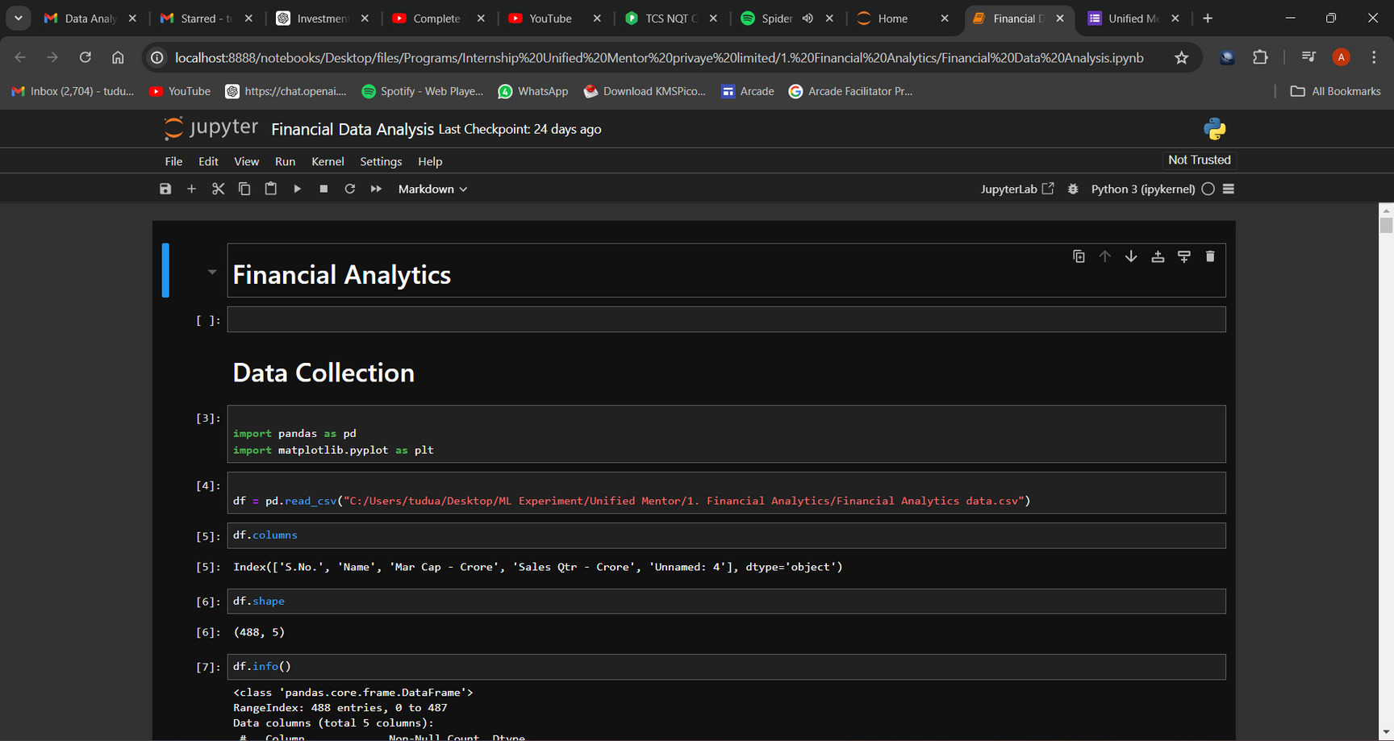
Screenshots

Slide 6
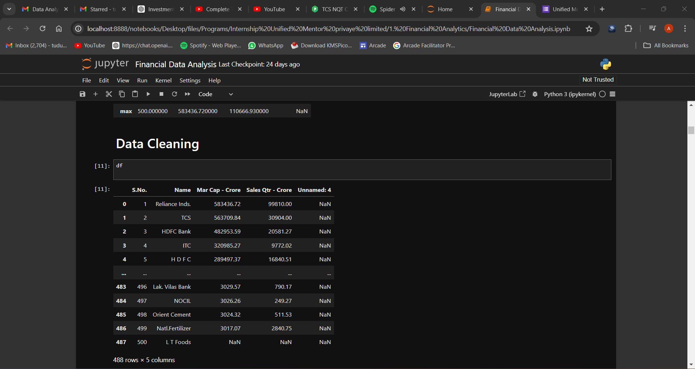

Slide 7
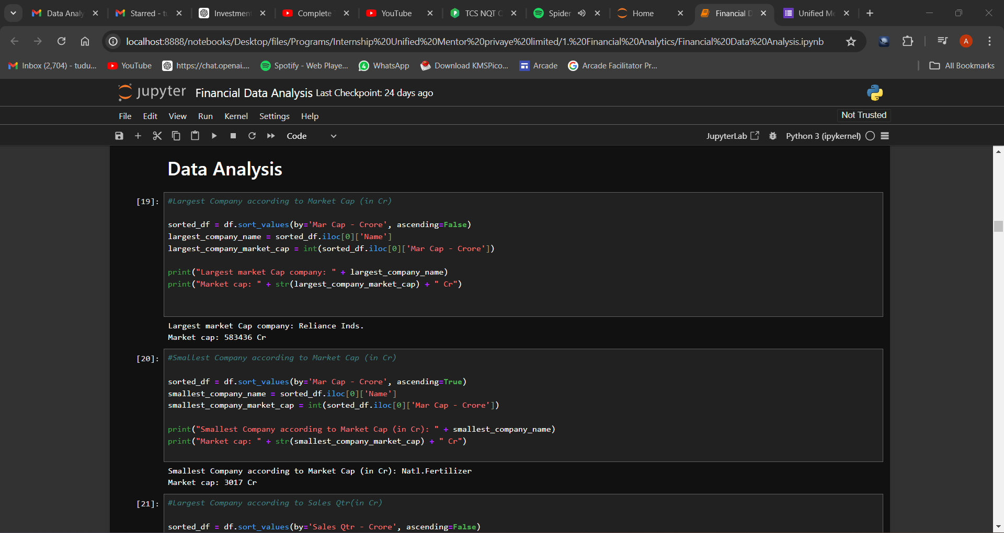

Slide 8
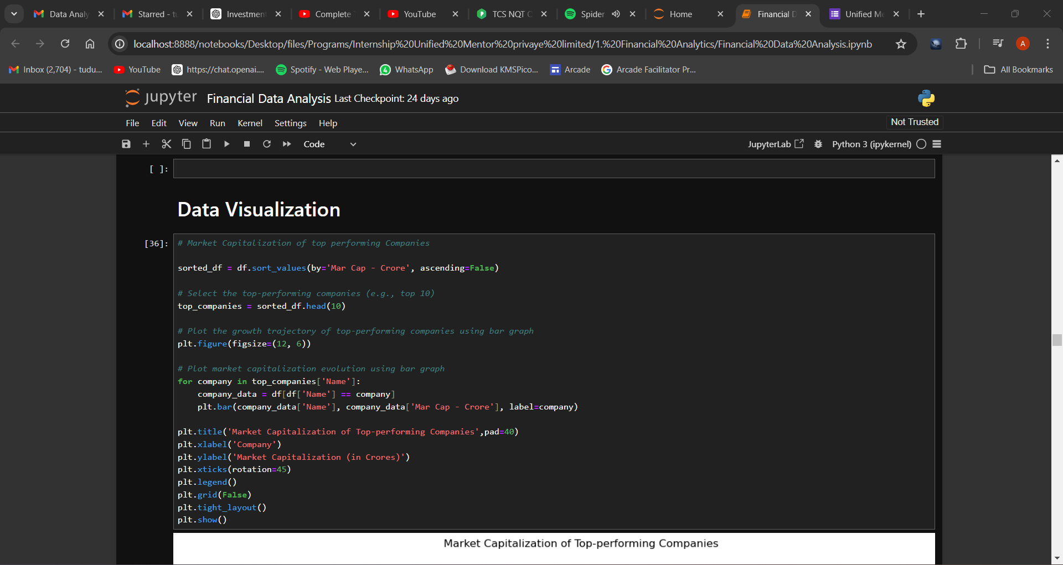

Slide 9
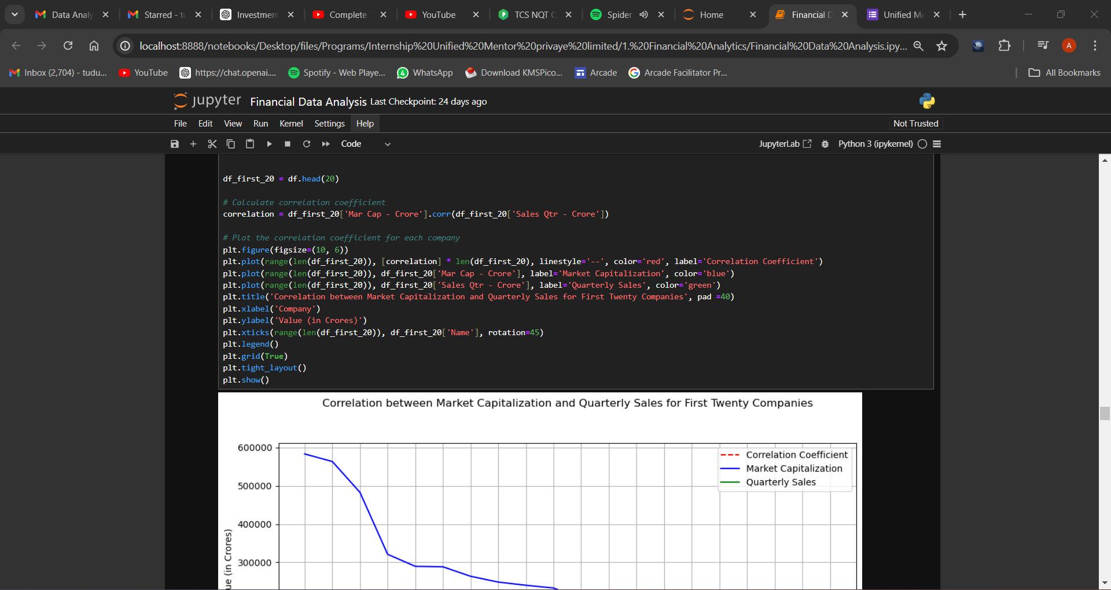

Slide 10
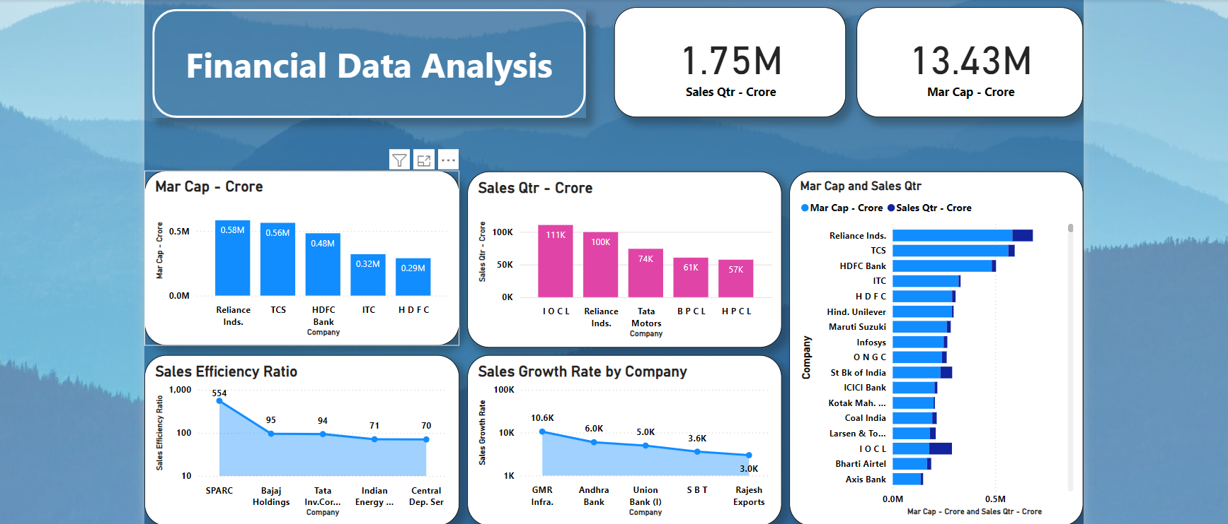
Dashboard

Slide 11
Insights
The top companies by market capitalization dominate the market, indicating their strong market presence and investor confidence. For instance, companies like Reliance Industries and Tata Consultancy Services are likely to top the list due to their substantial market values.
Companies with consistent quarterly sales growth are performing well and expanding their market reach. For example, if HDFC Bank shows a quarterly sales growth rate of 5%, it suggests strong financial health and efficient operations.
A high market capitalization to sales ratio might indicate overvaluation, whereas a low ratio could suggest undervaluation. Companies like Infosys might have a high ratio, reflecting investor optimism about future growth.
These companies are industry leaders and likely set market trends. Observing the top 10, such as Reliance Industries and TCS, helps understand market leadership and investment attractiveness.
Highlighting the top performers in market capitalization and sales showcases industry leaders and their competitive advantages. This information is crucial for benchmarking and strategic planning.

Slide 12
Thank you!

